Slide 1


Visveswaraya Technological University Belagavi, Karnataka, India -590018
Project report on
“ INVENTORY MANAGEMENT SYSTEM ”
BACHELOR OF ENGINEERING
IN
ARTIFICIAL INTELLIGENCE AND MACHINE LEARNING
by
Abhishek R. (1BC21AI001) Harshita M. Jain (1BC21AI005)
Inchara A. C. (1BC21AI006) Lokith (1BC21AI009)
DEPARTMENT OF ARTIFICIAL INTELLIGENCE
AND MACHINE LEARNING
BANGALORE COLLEGE OF ENGINEERING AND TECHNOLOGY

Slide 2
Acknowledgement
This project is prepared in the partial fulfillment of the requirement for the degree of Bachelor in Artificial Intelligence And Machine Learning . The satisfaction and success of completion of this task would be incomplete without heartfelt thanks to people whose constant guidance, support and encouragement made this work successful. On doing this undergraduate project we have been fortunate to have help, support and encouragement from many people we would like to acknowledge them for their cooperation.
Our first thanks goes to Bangalore college of Engineering And Technology University for designing such a worthy syllabus and making us do this project. Our next batch of thanks goes to the faculty of Management of BCET without whose help our project would have been impossible. This list includes Principal , Head of Department And all the faculty.
Our very sincere and heartfelt thanks go to our project supervisors who constantly guided us through the project time period. Without her guidance, our project would have been impossible. Last but not the least we want to thank every direct and indirect hands that were involved in completion of this project. This project has been a wonderful experience where we have learnt and experienced many beneficial things.

Slide 3
ABSTRACT
This project is aimed at developing a desktop based application named Inventory Management System for managing the inventory system of any organization. The Inventory Management System (IMS) refers to the system and processes to manage the stock of organization with the involvement of Technology system.
This system can be used to store the details of the inventory, stock maintenance, update the inventory based on the sales details, generate sales and inventory report daily or weekly based. In this system we are solving different problem affecting to direct sales management and purchase management.
Inventory Management System is important to ensure quality control in businesses that handle transactions resolving around consumer goods. Without proper inventory control, a large retail store may run out of stock on an important item. A good inventory management system will alert the wholesaler when it is time to record.
Inventory Management System is also on important means of automatically tracking large shipment. An automated Inventory Management System helps to minimize the errors while recording the stock.

Slide 4
INTRODUCTION
The project Inventory Management System is a complete desktop based application designed using the SQL software . The main aim of the project is to develop Inventory Management System Model software in which all the information regarding the stock of the organization will be presented.
It is an intranet based desktop application which has admin component to manage the inventory and maintenance of the inventory system. This desktop application is based on the management of stock of an organization.
The application contains general organization profile, sales details, Purchase details and the remaining stock that are presented in the organization. There is a provision of updating the inventory also. This application also provides the remaining balance of the stock as well as the details of the balance of transaction.
Each new stock is created and entitled with the named and the entry date of that stock and it can also be update any time when required as per the transaction or the sales is returned in case. Here the login page is created in order to protect the management of the stock of organization in order to prevent it from the threats and misuse of the inventory.

Slide 5
Problem statement
After analyzing many existing IMS we have now the obvious vision of the project to be developed. Before we started to build the application team had many challenges. We defined our problem statement as:
To make desktop based application of IMS for small organization.
To make the system easily managed and can be secured.
To cover all the areas of IMS like purchase details, sales details and stock management.

Slide 6
Background and Motivation
BACKGROUND
We started research by identifying the need of IMS in the organization. Initially we bounded our research to find the general reasons that emerged the needs of Inventory Management System. We used different techniques to collect the data that can clearly give us the overall image of the application. The techniques we used were interview with the developers, visiting online websites that are presented as the templates and visiting some organization to see their IMS application. Basically the following factors forced us to develop IMS application:
Cost and affordability.
Lack of stock management.
Effective flow of stock transfer and management.
Difficulty in monitoring the stock management.
MOTIVATION
Inventory systems are important because they help companies manage and track their goods accurately and to maintain sufficient inventory of finished goods so that demands of the customers are duly met .
To minimize the carrying costs of inventory namely cost of godown, insurance expenses, cost of funds involved in inventory and to control investment in inventory and keep it at an optimum level.

Slide 7
Objective
Primary objective :
The primary objectives of the project are mentioned below :
To fulfill the requirement for achieving the Bachelor’s degree of Artificial Intelligence And Machine Learning.
To know the fundamentals of the SQL and full stack web development.
Secondary objective :
The secondary objectives of this project are mentioned below :
To develop an application that deals with the day to day requirement of any production organization.
To develop the easy management of the inventory.
To handle the inventory details like sales details, purchase details and balance stock details.
To provide competitive advantage to the organization.
To provide details information about the stock balance.
To make the stock manageable and simplify the use of inventory in the organization.

Slide 8
Literature review
Products are considered as the business resources for the organization. This includes managing the product with appropriate way to review any time as per the requirement. Therefore it is important to have a computer based IMS which has the ability to generate reports, maintain the balance of the stock, details about the purchase and sales in the organization.
Before developing this application we came up with 2 Inventory Management System existing in the market, which helps to give the knowledge for the development of our project. These application software are only used by the large organization but so we came up with the application which can be used by the small company for the management of their stock in the production houses.
After analyzing the other inventory management system we decided to include some of common and key features that should be included in every inventory management system. So we decided to include those things that help the small organization in a way or other.

Slide 9
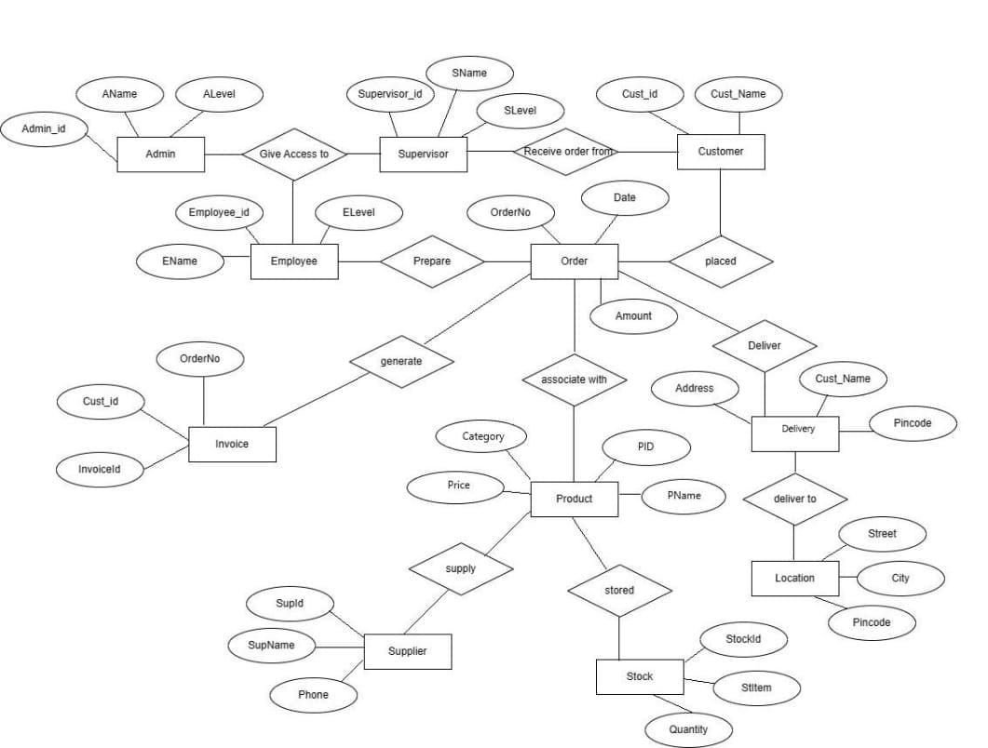
ENTITY-RELATION dIAGRAM

Slide 10
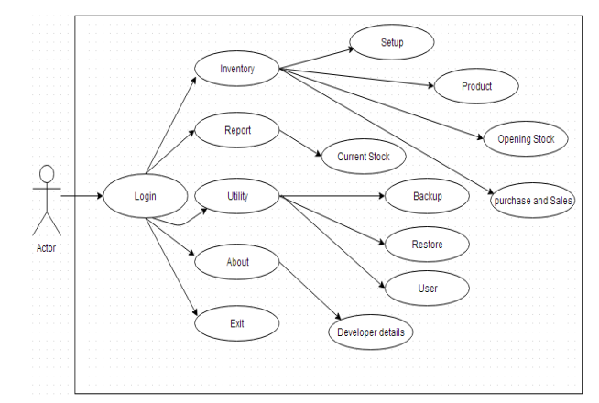
USE-CASE DIAGRAM

Slide 11
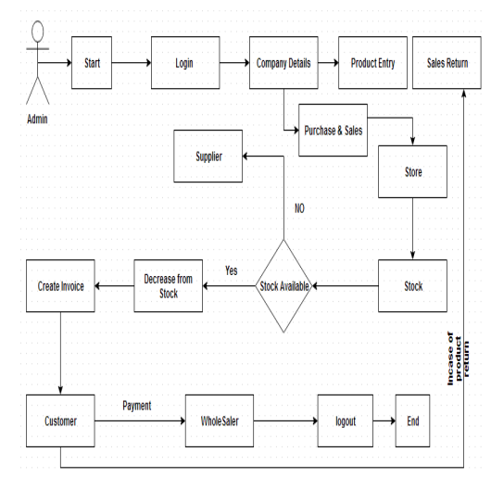
ACTIVITY DIAGRAM

Slide 12
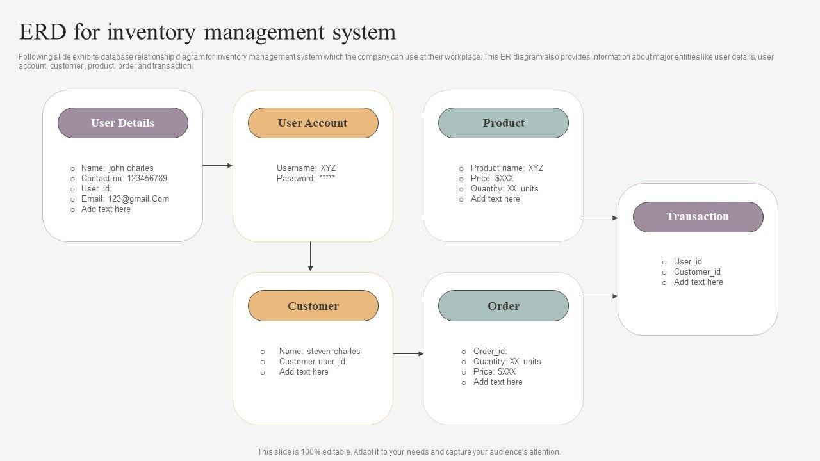
RELATION BETWEEN TABLES

Slide 13

USER INTERFACE DIAGRAM
Admin Login

Slide 14
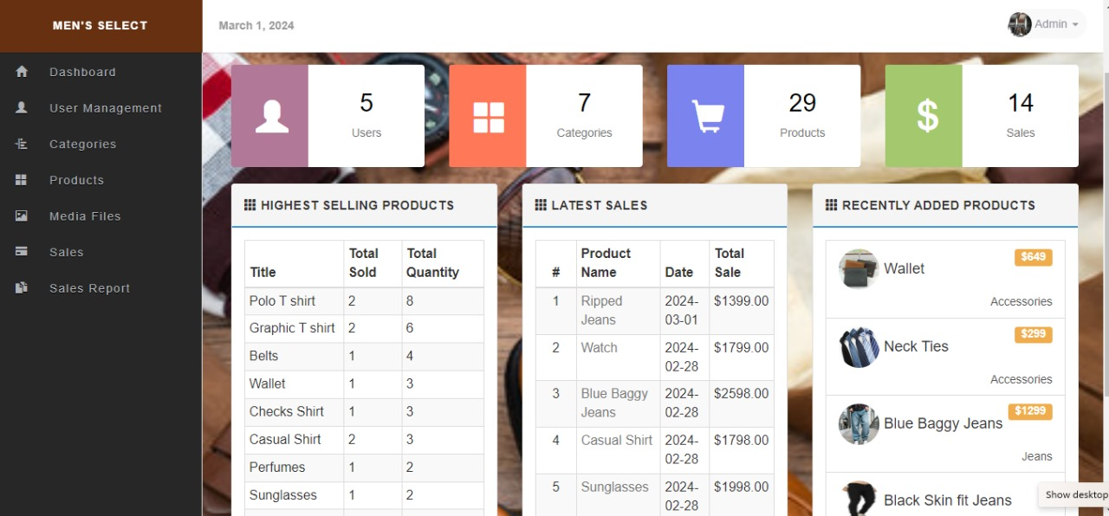
Admin Dashboard

Slide 15
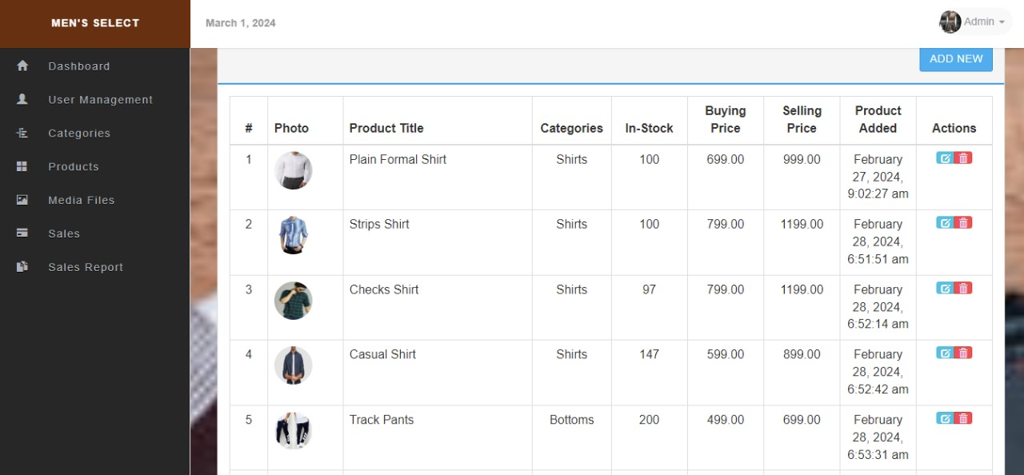
Add Product

Slide 16
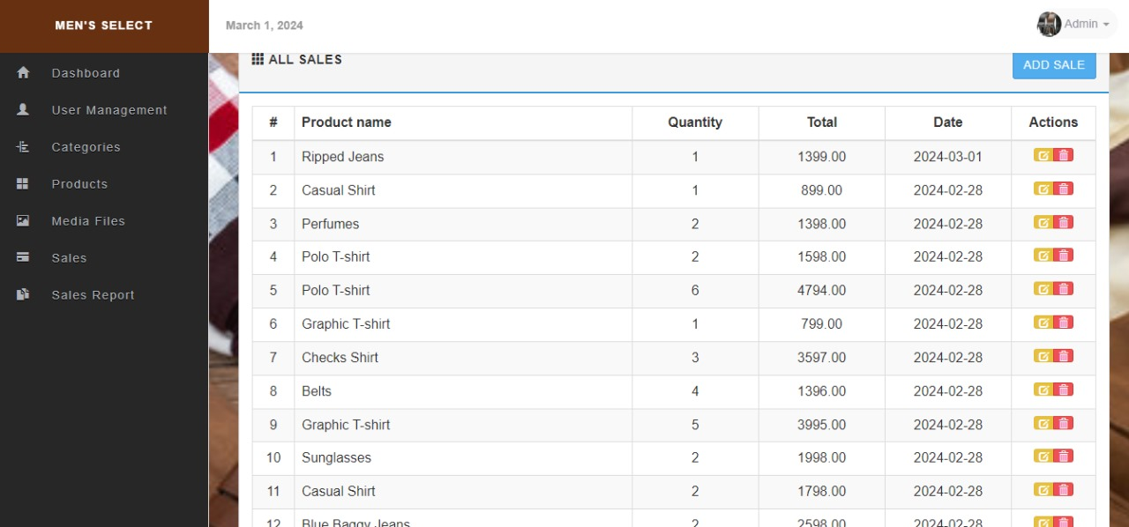
View Sales Report

Slide 17
Tools
Tools
PHP, HTML, CSS
These technologies are used to build the system. PHP and HTML are used to build the interface of the system and build the functionality of the system. CSS is used to define styles of the system.
XAMMP
XAMPP is a free and open-source cross-platform web server solution stack package. This software is used to connect to Apache and MySQL.
phpMyAdmin
phpMyAdmin is an open source and free administration tool for MySQL. This tool is used to insert the database.
Visual Studio Code
VS code is a free and open-source text and source code editor. This software is used to code the system.

Slide 18
Requirements
XAMMP Control Panel Version 3.3.0
phpMyAdmin Version 8.0.12. Laptop
Operating System: Windows 10
Processor: Intel(R) Core(TM) i5-5200U CPU @ 2.20GHz 2.19GHz

Slide 19
IMPLEMENTATION
Implementing an inventory management system (IMS) involves several steps, including designing the database schema, implementing it using a database management system (DBMS), and testing the system thoroughly. Here's a general outline of how you can approach this project:
1. Requirement Analysis
2. Database Design
3. Database Implementation
4. Data Population
5. System Implementation

Slide 20
TESTING
The purpose of software testing is to access or evaluate the capabilities or attributes of a software program’s ability to adequately meet the applicable standards and application need.
Testing does not ensure quality and the purpose of testing is not to find bugs. Testing can be verification and validation or reliability estimation.
The primary objective if testing includes:
To identifying defects in the application.
The most important role of testing is simply to provide information.
To check the proper working of the application while inserting updating and deleting the entry of the products.

Slide 21
THANK YOU !!

